Slide 1
Nemak meeting
4/7/2017

Slide 2
Current goals
Create cycling simulation using Nova Cast
Validate mold surface temperature using FLIR
Validate porosity analysis using CT scan data
Publish paper during Summer

Slide 3
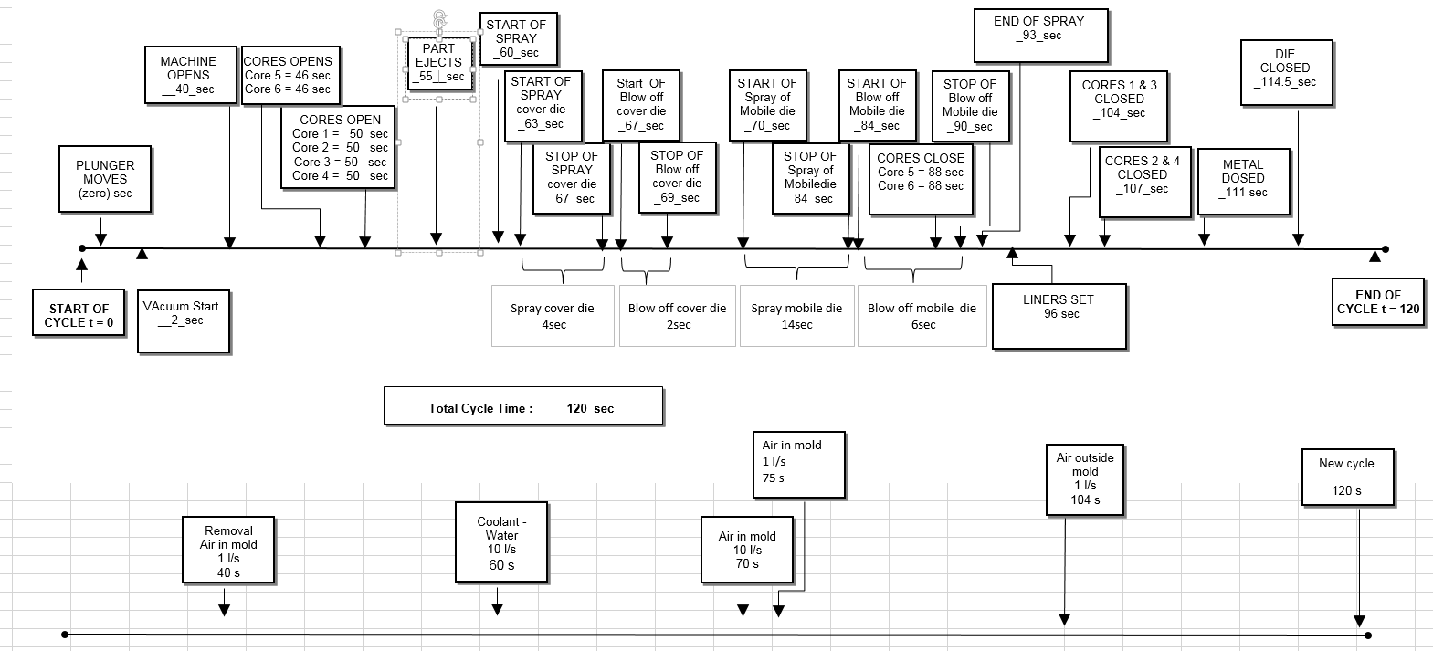
Cycle info

Slide 4
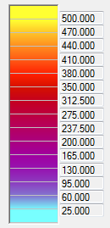
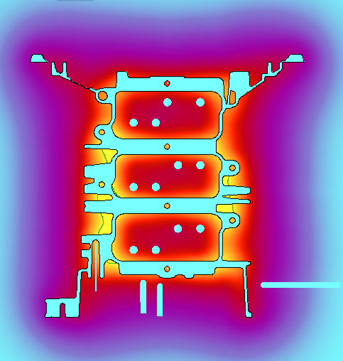
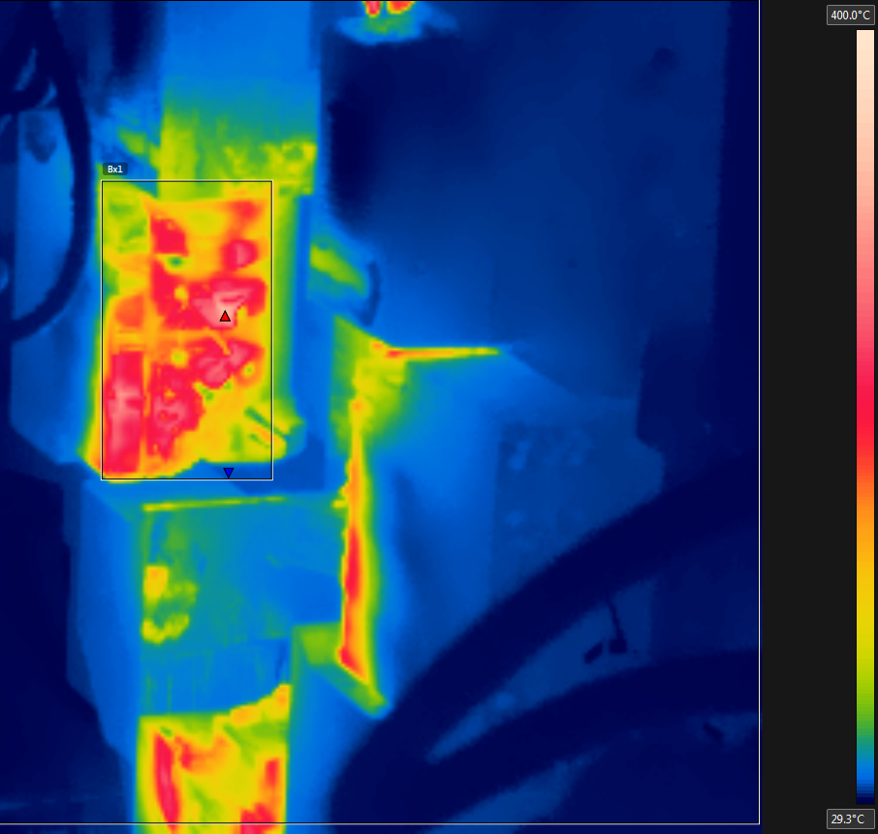
Mold surface temperature after 4th cycle, before spray
Simulation max temperature: 523 C
Flir max temperature: 350 C

Slide 5
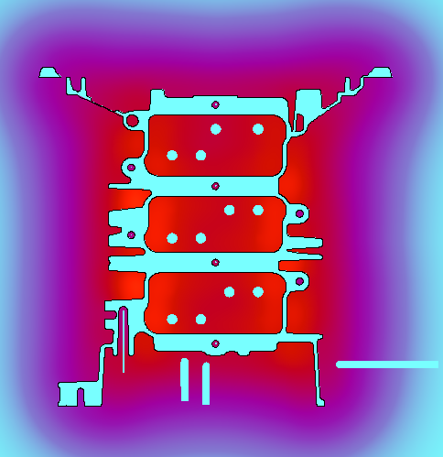
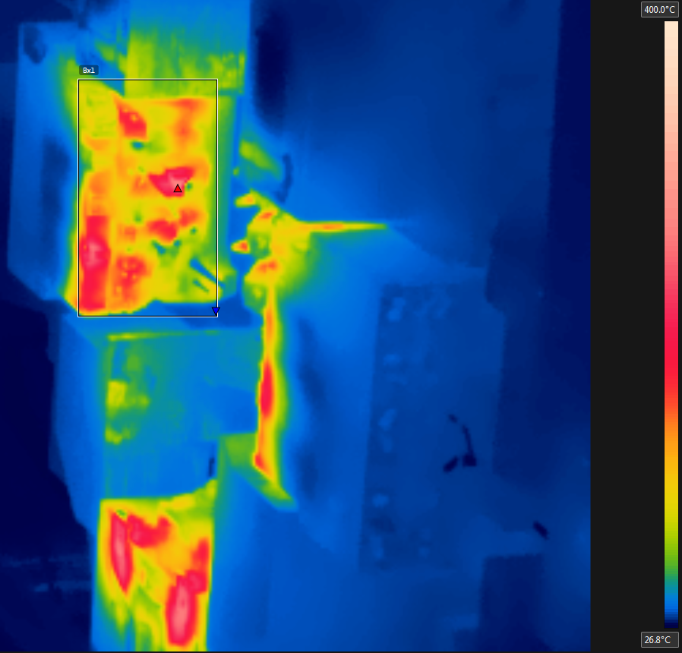
Mold surface temperature after 4th cycle, before spray
Simulation max temperature: 400 C
Flir max temperature: 310 C

Slide 6
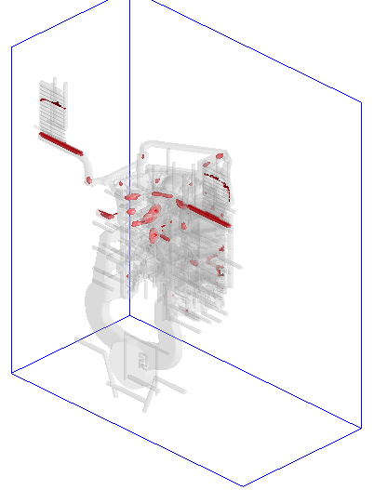
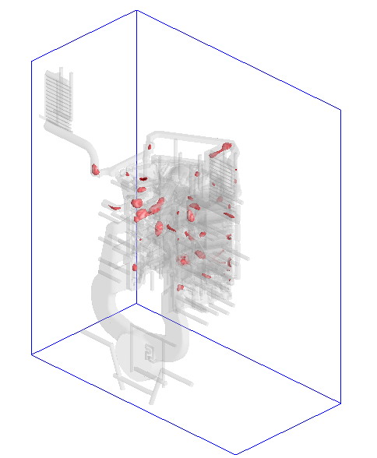
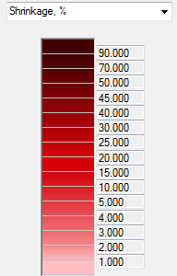
Shrinkage simulation
Cycling
No cycling

